Slide 1
Exoplanets
Mason Gingery

Slide 2
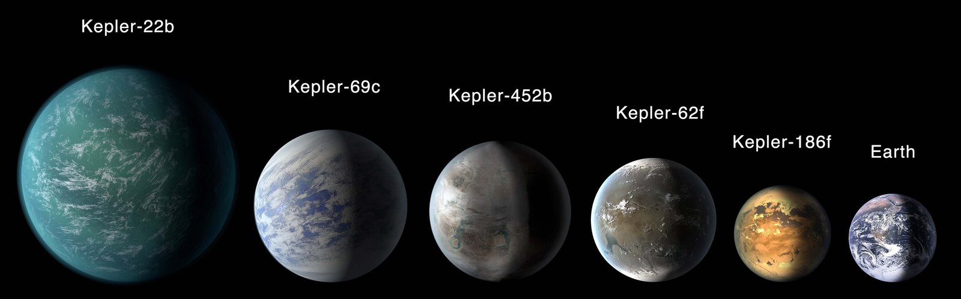
Background
What is an exoplanet?
Why are they important?
How do we observe them?

Slide 3
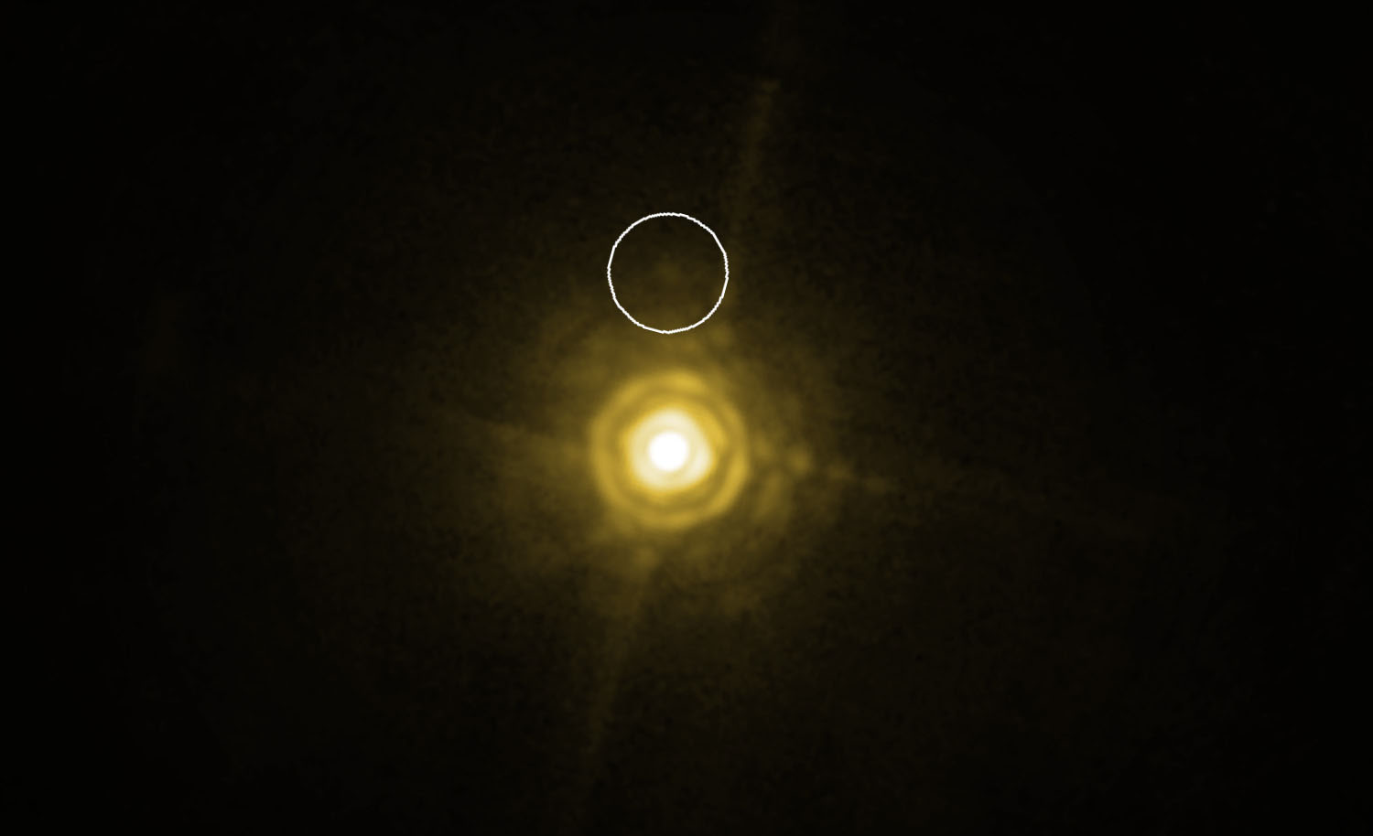
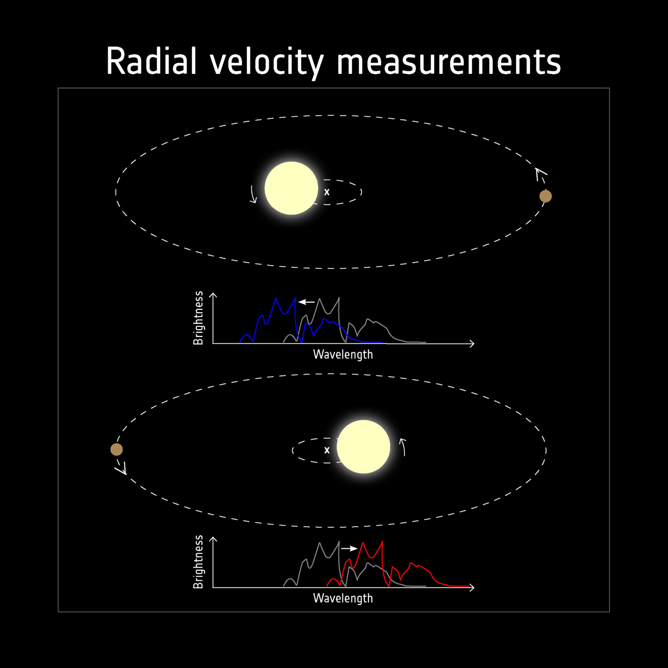
Motivation
Finding other potential habitable worlds
Several methods for observing exoplanets
Transit, radial velocity, direct imaging

Slide 4
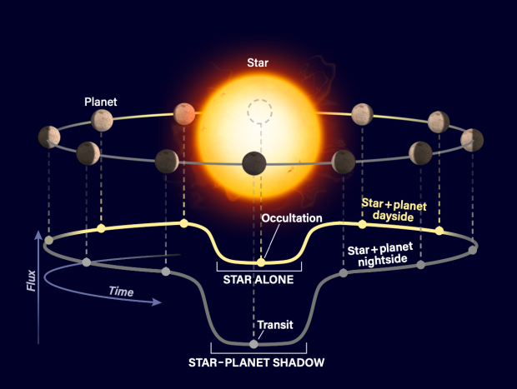
Underlying Physics and Math
Transit method

Slide 5
Methods
Use transit data to model in python
Run simple modeling codes to visualize

Slide 6
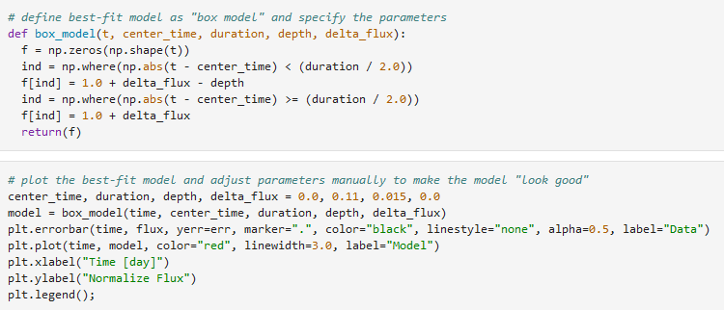
Code

Slide 7
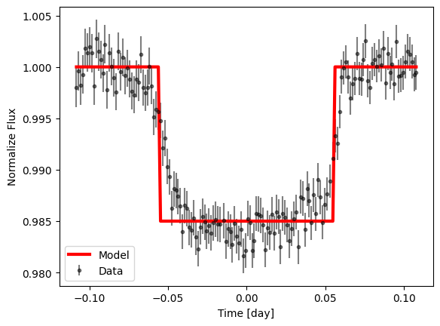
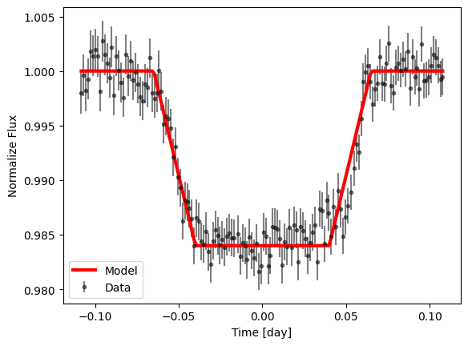
Results

Slide 8
Conclusion
Exoplanets have far reaching implications
Relatively easy to spot given wide variety of methods
Cater to different disciplines of astronomical science

Slide 9
References
https://www.esa.int/ESA_Multimedia/Images/2019/02/Detecting_exoplanets_with_radial_velocity
https://www.astronomy.com/science/ask-astro-how-many-exoplanets-does-the-transit-method-miss/
https://www.gps.caltech.edu/gps-research/research-programs/planetary-research-option/research-areas/exoplanets-planetary-astronomy
https://www.wired.com/2010/01/direct-spectrum-exoplanet/

